Slide 1

Loan Default Prediction for Crescent Bank
Group - 12:
Sai Charan Boyanapalli
Naveen Sreeram Vallabhapurapu
Jayesh Rathore
Shraddha Kodancha
This Photo by Unknown author is licensed under CC BY.

Slide 2
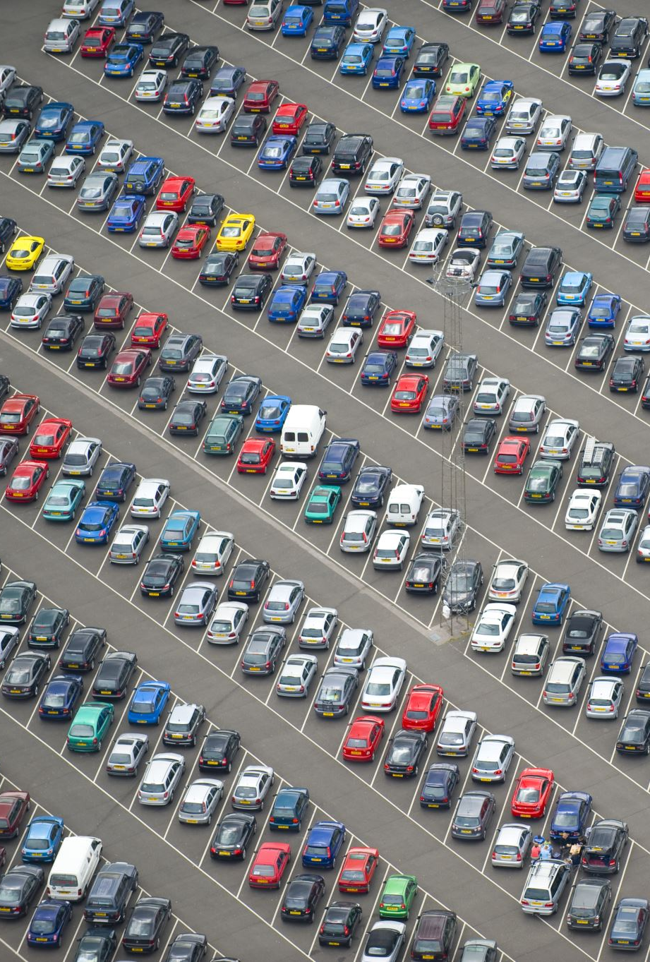
The Business Problem
Crescent Bank makes loans backed by automobiles
•They loan an individual the cash to purchase a vehicle
•Customers pay back over the course of 5-7 years
•Many of them are “sub-prime”. That means that they have had problems in the past in paying off another debt
Sometimes they stop paying back, or become “delinquent”
•This might be because they are regular “late payers”, and will get around to it
•It might be because they have run into financial problems and won’t be able to pay us

Slide 3
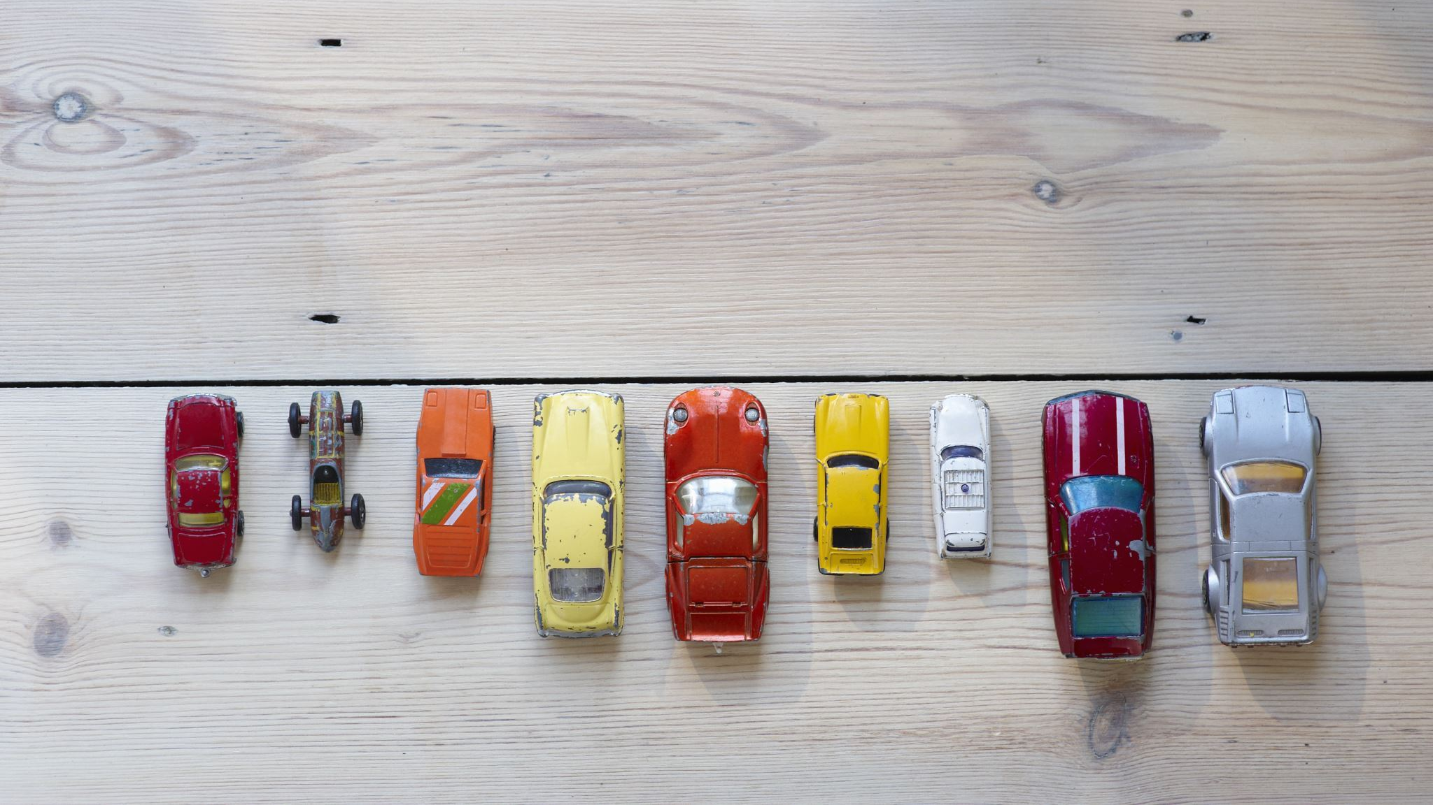
Model output
The model helps to figure out which customers are more likely to pay back so that bank can-
•Avoid bothering them with calls from our servicing staff
•Or can plan to try and retrieve vehicles from the ones who aren’t very likely to pay
The model’s output gives us the probability of likelihood of a customer paying the loan amount to the bank within 30 days after they become delinquent.

Slide 4

Strategy Design
The model’s output gives us the probability of likelihood of a customer paying the loan amount to the bank within 30 days after they become delinquent.
Output=0 Customer will default
Output=1 Customer will not default.

Slide 5
Steps in the model
Removing all the duplicate observations.
Building a Correlation Heat map and identifying correlated features to avoid multi-collinearity.
We have a DPD as our dependent variable defined as "The No. of Days past his due Date". We have encoded them into two sets using Binning method.
Missing value Imputation
Normalizing
Outlier Treatment
Feature Engineering
Model Building

Slide 6
Raw input data: Shown in Excel attached. Some of the most important columns are as explained below:
Output/Target variable:
DPD_bool = Whether or not a customer is going to be paying the loan amount after 30 days past due date.
Feature | Definition
Balance_percent_Loan | Balance/original loan amount
Financed_Amount | Total amount financed
REM_TM_RAT_OBS | ratio of remaining term to original term
F0146_PAST_DUE_PAYMENTS | Past due payment amount excluding fees
DSLP | Days since last payment
PMT_RAT_OBS | Last Payment to scheduled payment ratio
D31P_TOT_6 | Number of Days 31+ DPD in the last 180 days
DD_AVG_1 | Average of days past due in last 30 days
Promise_status_o | Current open promising flag
BAL_RAT_TRN_6 | 180 day rolling monthly change (slope) of outstanding balance to amount financed ratio

Slide 7
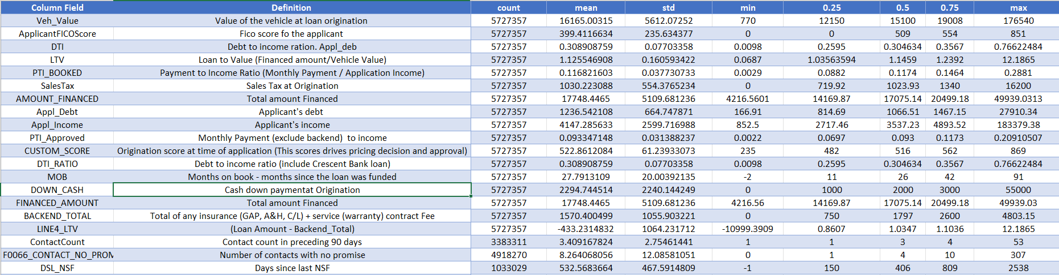

Slide 8
Observation Exclusions – Out of the 91 observations. We have removed the below columns due to reasons as shown below:
Multicollinearity | High cardinality and no uniqueness | Having more than 30% missing values | No relation with output | Final data | Total columns16
16 | 7 | 6 | 21 | 41 | 91

Slide 9
Train and Test
SAMPLE | % of Data Assigned | No . Of Observations
TRAINING | 80% | 50350
TEST | 20% | 12588
TOTAL | 100% | 62938

Slide 10
One-hot Encoding
Since all our inputs are continuous(no categorical inputs), we do not perform one hot encoding.

Slide 11
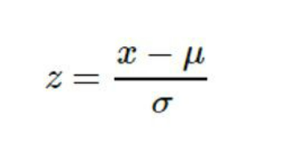
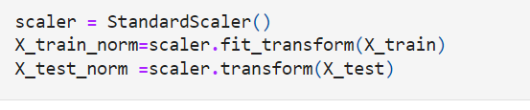
Normalization Technique:
StandardScaler standardizes a feature by subtracting the mean and then scaling to unit variance. Unit variance means dividing all the values by the standard deviation.
Also, unlike normalization, standardization does not have a bounding range. So, even if you have outliers in your data, they will not be affected by standardization.
Where μ is the mean (average) and σ is the standard deviation from the mean; standard scores
(also called z scores) of the samples are calculated as follows:
Code Snippet of Normalization Technique in the model:

Slide 12
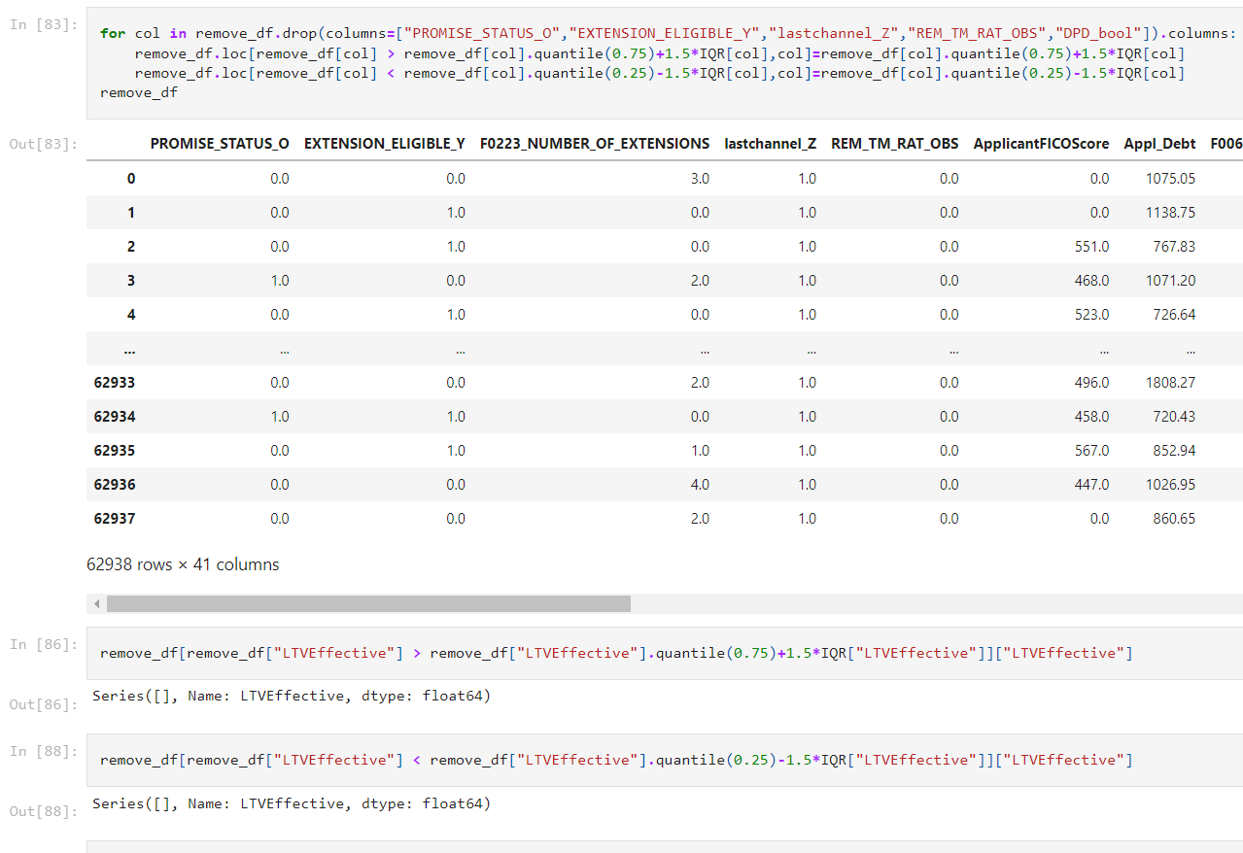
Outlier Treatment
In this project, we use the IQR method for outlier detection.
IQR= Q3-Q1
We define two range values as below:
Lower bound= Q1-1.5*IQR
Upper bound= Q3+1.5*IQR
Any data point less than lower bound and more than upper bound is considered an outlier.
All the outliers are capped at lower bound and upper bound

Slide 13
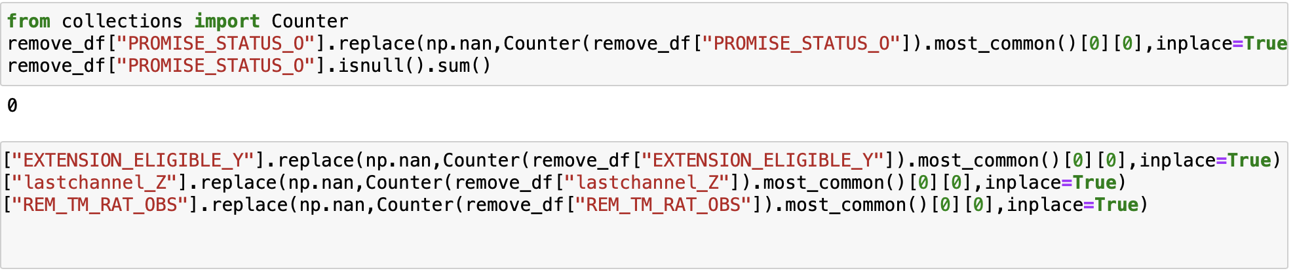
Missing value Imputation
In this project, since most of the columns are normally distributed, we are imputing the missing values with mode and median.
The features with low cardinality and less unique values are replaced with mode and rest of the others with Median

Slide 14
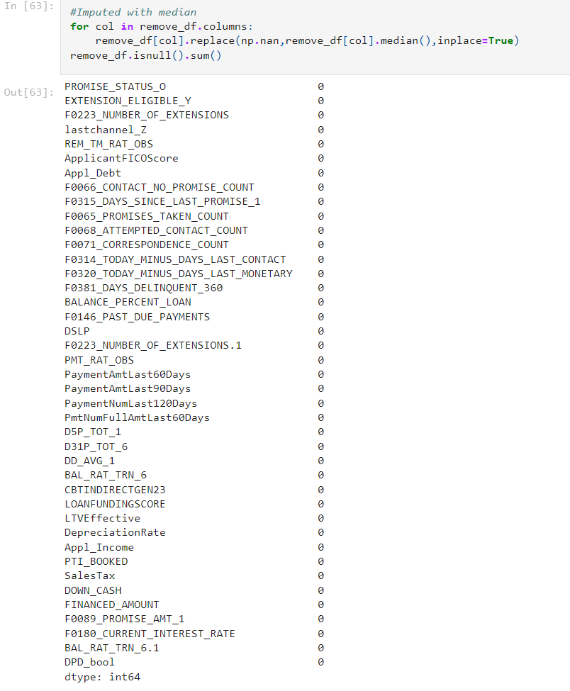
Missing value Imputation
In this project, since most of the columns are normally distributed, we are imputing the missing values in each column with the median values.

Slide 15
Feature Engineering
We have defined new features based on the DPD variable.
DPD is a continuous variable. Our model is classification, so we have encoded our variable as DPD_bool.
DPD_bool = True --> if the due past date is great than 30[30,inf)
= False --> if the due past date is less than 30(-inf,30]

Slide 16
Feature Selection
Approach : 1
There are 41 important features to be considered for the model after EDA.
Approach : 2
After running the XG Boost model, we select the features with importance > 0.01(1%)

Slide 17
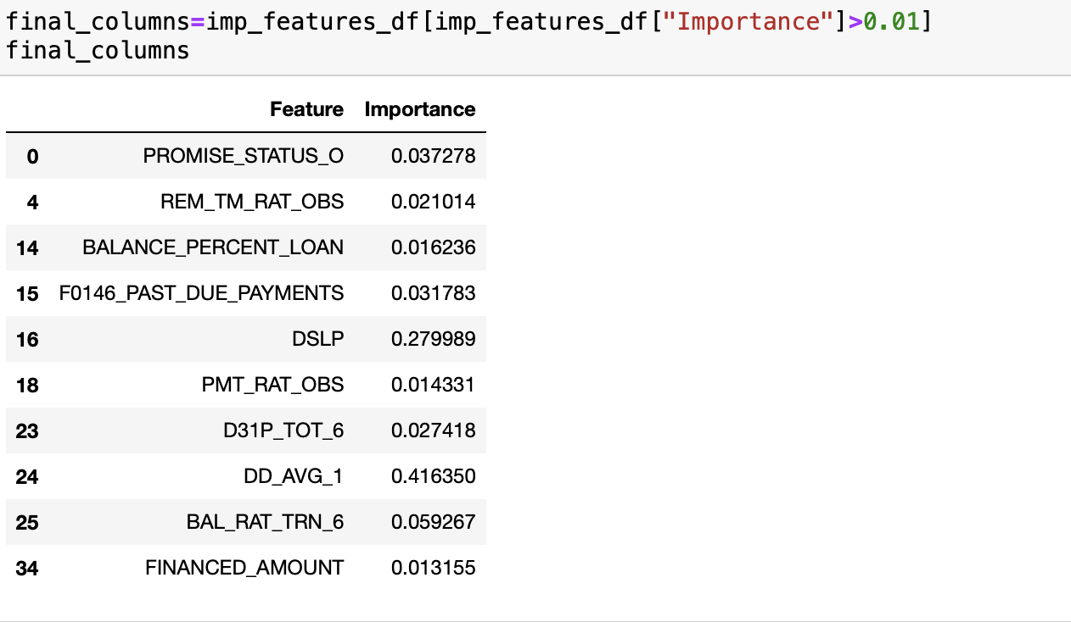
Cont'n

Slide 18
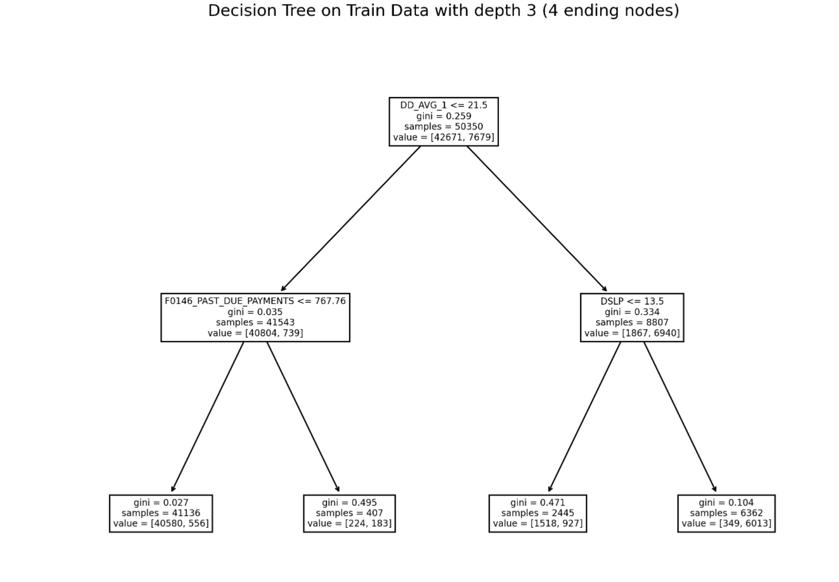
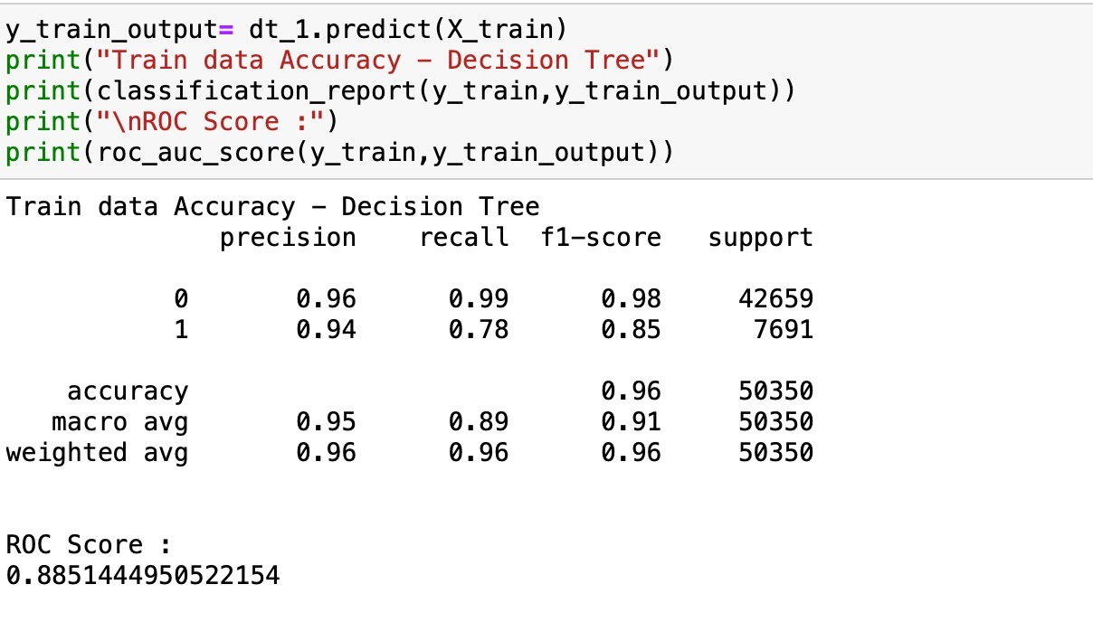
Decision Tree:

Slide 19
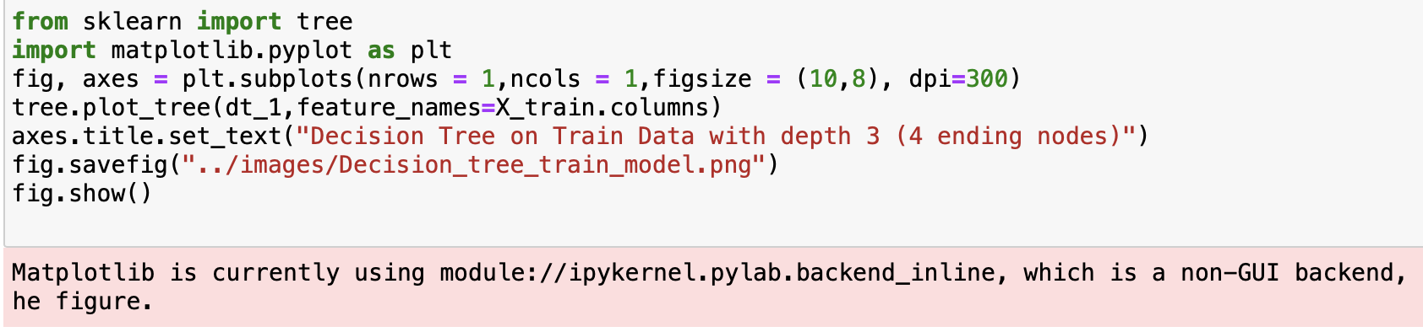
Packages used to Visualize DT
Sklearn,
Tree

Slide 20
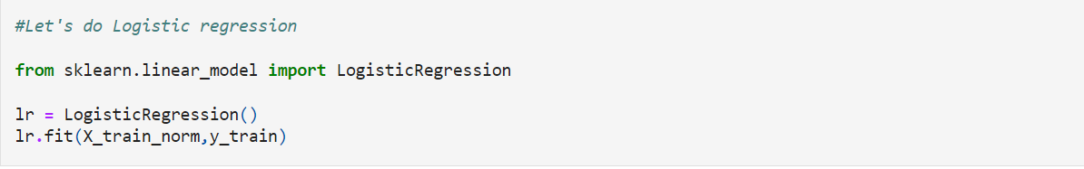
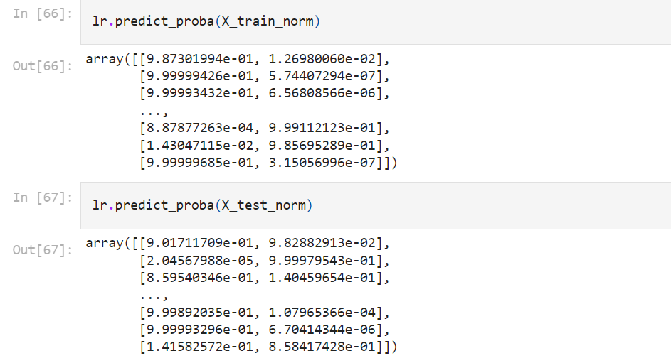
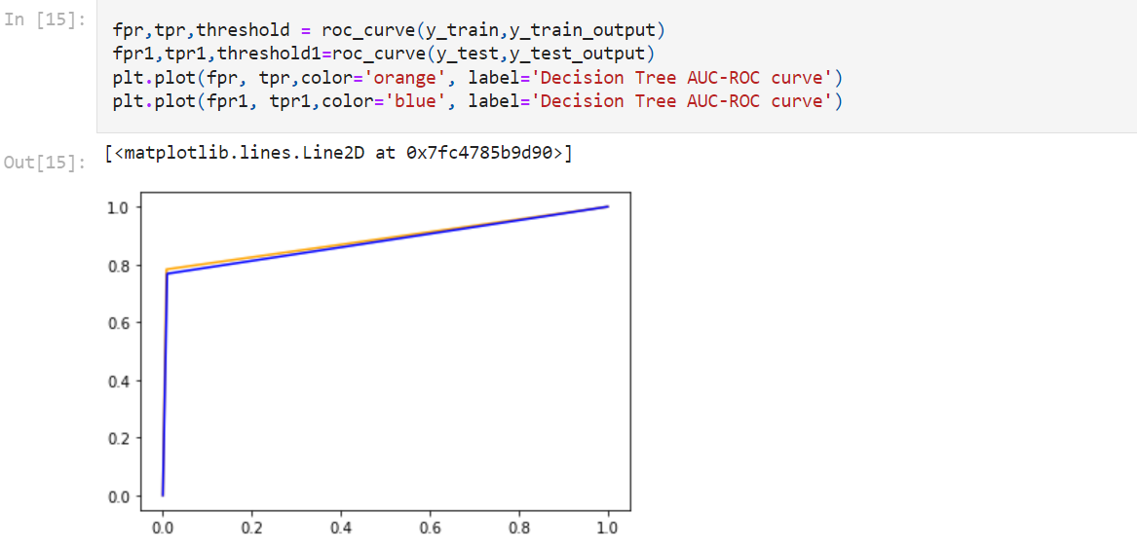
Logistic Regression has been performed to predict the probabilities for respective Training and Test data.
AUC-ROC Curve
Accuracy of train_data = 95.94%
Accuracy of test_data= 51.85
Packages Used:
Logistic Regression from linear_model.
classification_report,roc_auc_score,roc_curve from metrics.

Slide 21
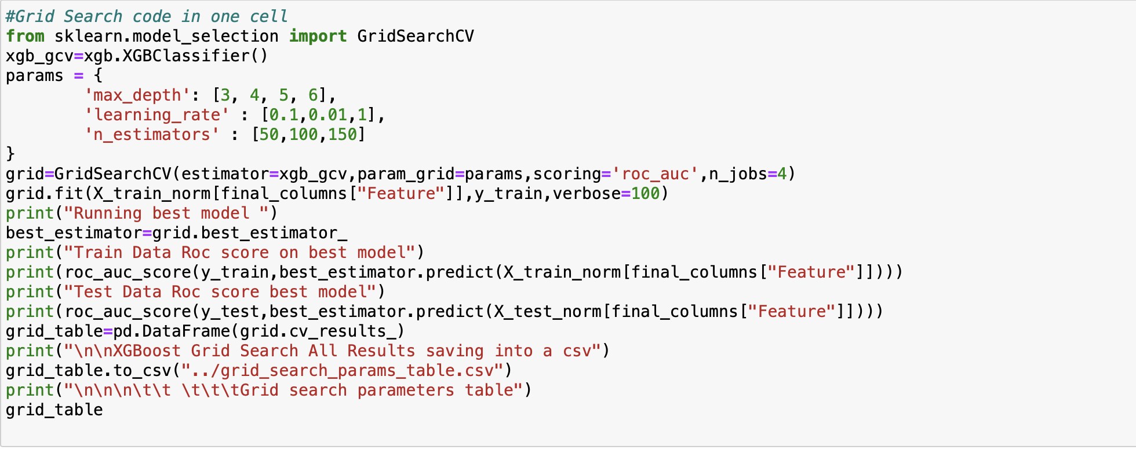
Grid Search code

Slide 22
XGBoost Grid Search code
from sklearn.model_selection import GridSearchCV
xgb_gcv=xgb.XGBClassifier()
params = {
'max_depth': [3, 4, 5, 6],
'learning_rate' : [0.1,0.01,1],
'n_estimators' : [50,100,150]
}
grid=GridSearchCV(estimator=xgb_gcv,param_grid=params,scoring='roc_auc',n_jobs=4)
grid.fit(X_train_norm[final_columns["Feature"]],y_train,verbose=100)
print("Running best model ")
best_estimator=grid.best_estimator_
print("Train Data Roc score on best model")
print(roc_auc_score(y_train,best_estimator.predict(X_train_norm[final_columns["Feature"]])))
print("Test Data Roc score best model")
print(roc_auc_score(y_test,best_estimator.predict(X_test_norm[final_columns["Feature"]])))
grid_table=pd.DataFrame(grid.cv_results_)
print("\n\nXGBoost Grid Search All Results saving into a csv")
grid_table.to_csv("../grid_search_params_table.csv")
print("\n\n\n\t\t \t\t\tGrid search parameters table")
grid_table

Slide 23
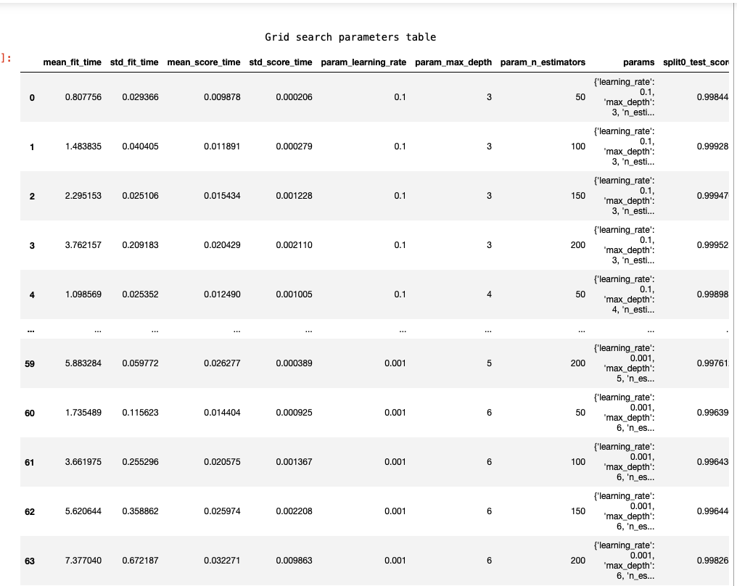
Screenshot of Grid search table

Slide 24
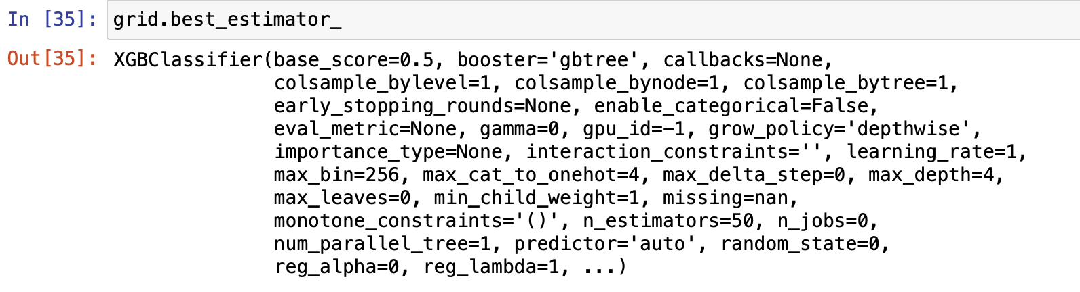
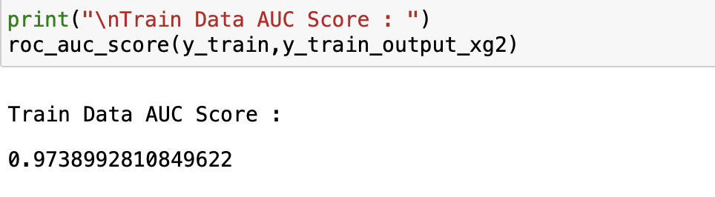
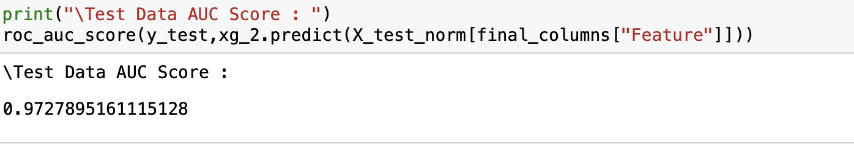
Best Estimator:

Slide 25
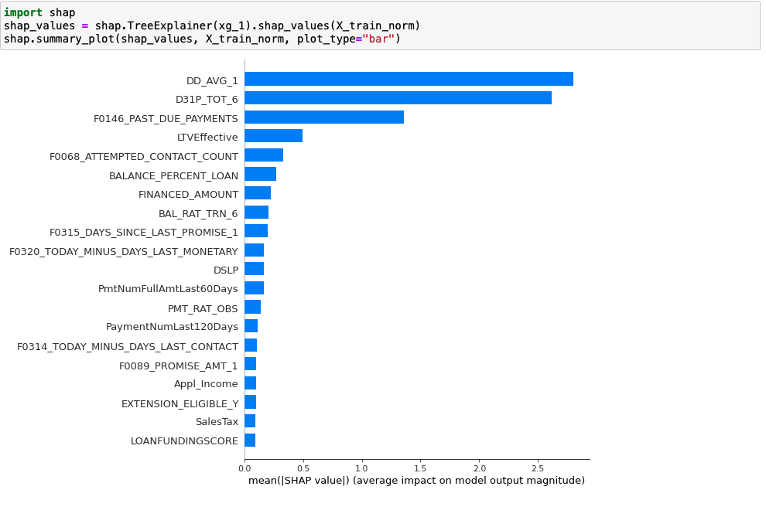
SHAP SUMMARY PLOT

Slide 26
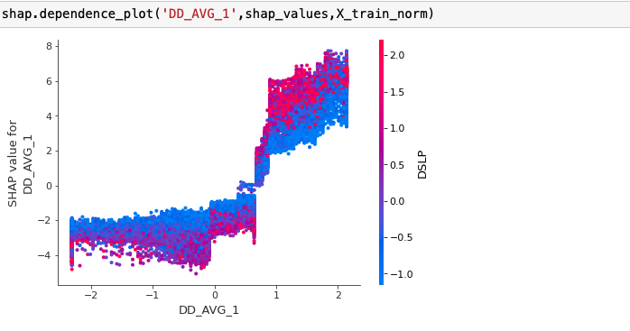
SHAP DEPENDENCE PLOTS
Plot - 1

Slide 27
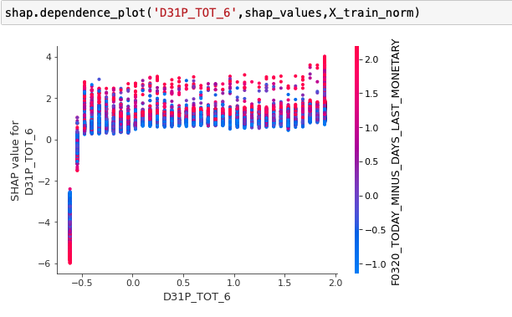
Cont't
Plot - 2

Slide 28
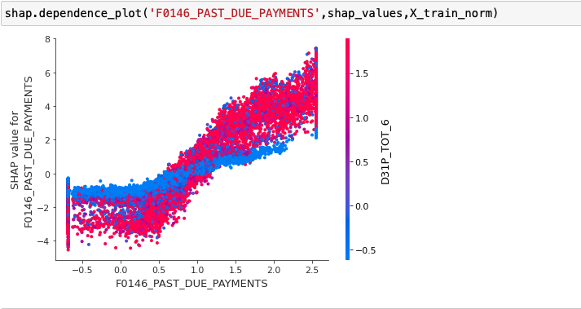
Cont'n
Plot - 3

Slide 29
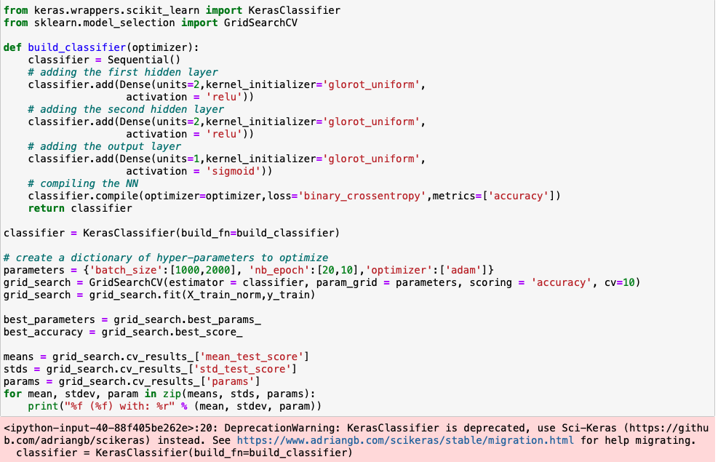
Grid search on [hidden layers – 2 values, Activation Function – 2 values, # units – 2 values]

Slide 30
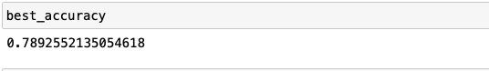
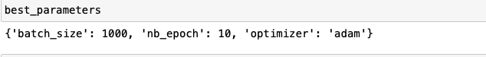
Best parameters of NN

Slide 31
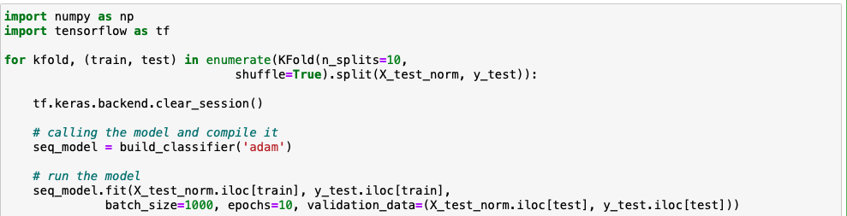
10-Fold Cross Validation with the best parameters of NN
Code:

Slide 32
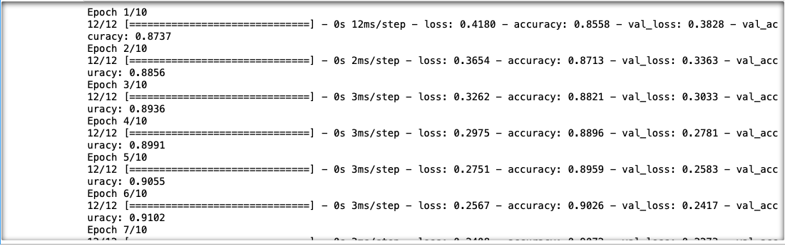
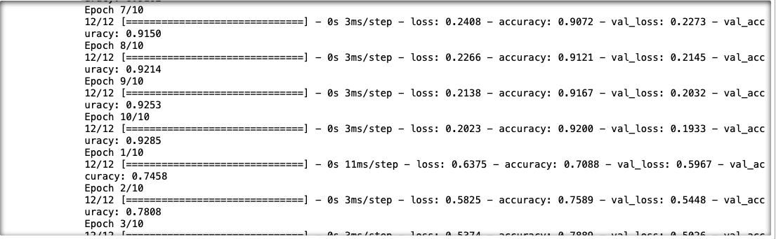
Performance Metrics:

Slide 33
XG Boost Vs Neural Networks
XGBoost is the preferred model here, as it has high accuracy compared with the Neural Network model.
Though XGBoost takes longer time to train the data, Neural network needs more training data compared with XGBoost.

